Slide 1









CYBER RISK ANALYSIS
PRESENTATION 2026
Student Name
Student Email
Guide
Drashti Upadhyay
Kiya Shah
drashtiupadhyay912@gmail.com shahkiya52@gmail.com
Jyoti Ma'am

Slide 2
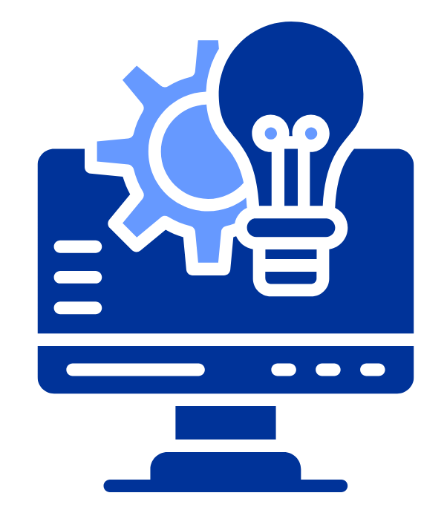
OUTLINE
Abstract of the Project
Problem Statement
Proposed Solution
System Architecture
Live Demo of the Project
Embedded Video of Project
Conclusion
Future Scope

Slide 3
Abstract
This project analyzes global cyber risk data using an interactive dashboard to identify high-risk attack types, vulnerable industries, and financial impact. By transforming complex security data into clear visual insights, it helps organizations understand threats, prioritize risks, and support proactive, data-driven cybersecurity decisions.

Slide 4

Problem Statement
Cyberattacks are becoming more common and advanced. Organizations collect lots of security data, but they often struggle to make sense of it quickly. Without clear insights, it’s hard to prioritize threats or use resources wisely, leaving them exposed to risk.

Slide 5

Proposed Solution
Integrate real-time threat intelligence and AI models for proactive cyber risk prediction. Enable industry benchmarking to guide smarter security investments. Enhance predictive insights for faster response and reduced impact.

Slide 6
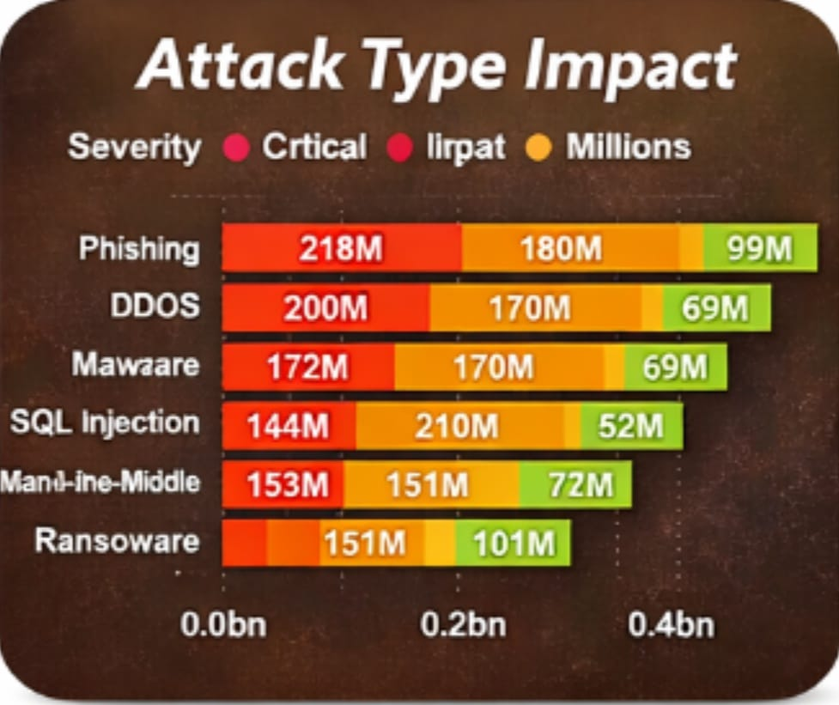
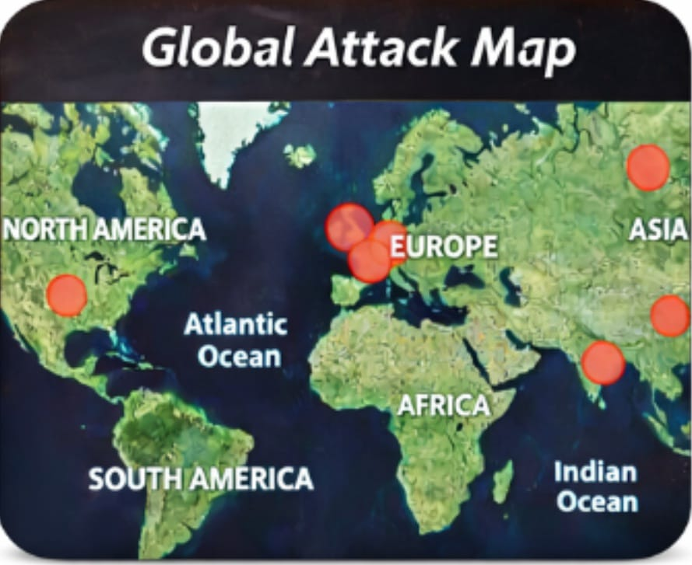
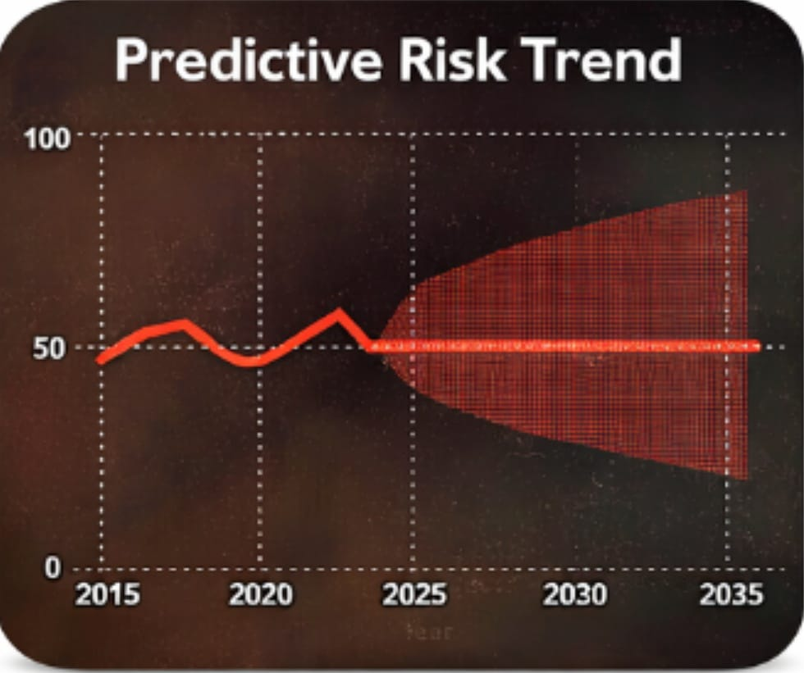



Live Demo of Project
Here’s the list of some demo of the projects -
Demo 1
Demo 2
Demo 3
Phishing is the most severe and widespread attack, while ransomware causes the highest financial damage.
Cyber risk is projected to increase significantly through 2035, highlighting the need for proactive defense planning.
North America, Europe, and Asia are the most targeted regions globally, indicating concentrated cyber threat activity.

Slide 7
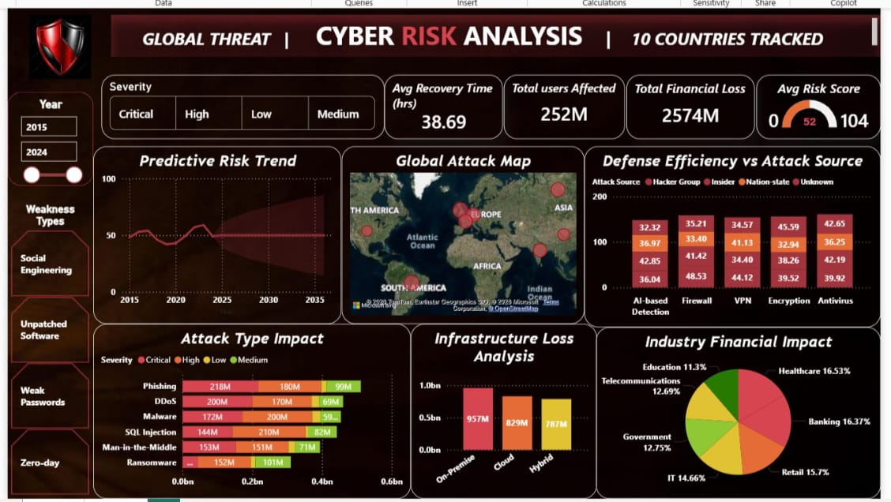
Image of Project Demo

Slide 8

Conclusion
This Cyber Risk Analysis Dashboard turns complex data into clear visuals. It helps organizations understand their risks, improve their defenses, and make smarter decisions. By using such tools, businesses can build stronger cyber resilience and reduce potential losses.

Slide 9

Future Scope
Integrate real-time threat intelligence and AI models for proactive cyber risk prediction. Enable industry benchmarking to guide smarter security investments. Enhance predictive insights for faster response and reduced impact.

Slide 10
Thank You
Notes:
thank you very much for joining this PPT, keep learning.
10

